Slide 1
Language consulting practices in Hungary from the perspective of Language Management Theory
Zsófia Ludányi | Dorottya Jakab
HUN-REN Hungarian Research Centre for Linguistics | HUN-REN Hungarian Research Centre for Linguistics ELTE, Eötvös Loránd University
Paper presented at the Language Management Seminar. Prague: Charles University, 10 May 2024

Slide 2
Introduction & outline
Zsófia Ludányi PhD
research group leader / Hungarian Usage and Language Consulting Research Group
Dorottya Jakab
junior research fellow / Hungarian Usage and Language Consulting Research Group
PhD student / Eötvös Loránd University
Outline:
What is language consulting?
Definition, types, interpretation as language management
Language consulting at the HUN-REN Hungarian Research Centre for Linguistics
Introduction of HRCL and LCS
Practices of language consulting at LCS
Who are the LCS’ inquirers? – results of a questionnaire survey
The main strategies of answering language consulting emails
Answering spelling questions/problems
Computer aided spelling advice
Answering language usage problems

Slide 3
What is language consulting? Definition, types, interpretation as language management

Slide 4
What is language consulting?
The term ’language consulting’ can be interpreted in different ways in the different research studies
In our presentation this term describes interactions in which the first language of the advisor and the advice seeker are the same, and the process of advice is linked to this language
Three important aspects: subject, content, participants
Subject: the advice process is focused on a problem related to the use of a language
e.g. What is the correct spelling of a phrase?, Does the given phrase exist? What does the given term mean? etc.
Content:
Every interactions: question + advice
Frequent but not permanent parts: feedbacks (e.g. expressing thanks)
Participants:
Consultant
Inquirer

Slide 5
Comparison of everyday and institutional forms of language consulting
Factors | Everyday language consulting | Institutional language consulting
Circumstances | simple communicative situations (e.g. a conversation between a mother and her child or two friends) | communicative situations with an institutional background, linked to a scientifically relevant institution
Participants | - min. two person who are from the same speech community - there is not necessarily a difference in expertise between the partcipants | - min. two person who are from the same speech community, - there is always a difference in expertise between the participants
Sources of advice | the general and shared knowledge about the use of language in their community | scientifically relevant books, research data and results

Slide 6
Language consulting as language management (Nekvapil 2009, Beneš et al. 2018, Kimura & Fairbrother 2020)
Institutional language consulting
Interface between the micro and macro levels and the simple and organized forms of language management
Ordinary language users noting linguistic phenomena that attract attention (micro level)
Consult a language consulting service to be informed about the observed phenomena (macro level)
Language users accept the adjustment design that the asked consulting sercive proposes (micro level)*
*Inquirers not always accept the suggestion of LCS, sometimes they reject it, or or implemented only partially

Slide 7
Language consulting as language management
Everyday language consulting
It is an open question, since there is not much research available on this
Obviously not organised in the same sense as the institutional form → BUT it certainly shows some kind of purposefulness and planning on the part of the inquirers
According to Rudwick's 2022 research, it could be a possible solution to consider everyday language consulting as
semi-organized language management practice,
that represents the meso level of language management

Slide 8
Language consulting at the HUN-REN Hungarian Research Centre for Linguistics

Slide 9
Organizational changes at the HRCL
1949–2019: Research Institute for Linguistics of Hungarian Academy of Sciences
2019–2021: Hungarian Research Institute for Linguistics (of the Eötvös Loránd Research Network)
2021 – September 2023: Hungarian Research Centre for Linguistics (of the Eötvös Loránd Research Network)
1 September 2023: HUN-REN Hungarian Research Centre for Linguistics (HRCL)
Since its foundation, the LCS has been operating at the Hungarian Research Centre for Linguistics (HRCL) and its predecessor institution, the Research Institute for Linguistics of the Hungarian Academy of Sciences
Currently the HRCL belongs to the Hungarian Research Network (HUN-REN)

Slide 10
Language management practices at the HRCL
Two types of activities:
Basic linguistic research
Language management activities
So-called public tasks
Creation of:
dictionaries
language databases
corpora
and even descriptive grammars
They can serve as tools for language management → codification role

Slide 11
The Language Consulting Service of HRCL
The Language Consulting Service (LCS) is the oldest and most traditional institution of language consulting – HUN-REN Hungarian Research Centre for Linguistics, formerly the Institute for Linguistics of the Hungarian Academy of Sciences
Since the institution’s foundation (1949)
In 2024 the LCS is run by Hungarian Usage and Language Consulting Research Group
There are 5 researchers who also work as language consultants
Special Working Group within the research group: Names Working Group (with 3 researchers)
The research group’s dual profile: research + service

Slide 12
Channels of language consulting
The channels of consulting have changed in line with technological developments
At the beginning: postal mail → nowadays: rare
Later: postal letters, personal consulting, telephone
Nowadays: email and telephone
Email
Available working days of the week
Telephone
2 * 4 hours per week, Tuesdays and Thursdays

Slide 13
Organization of the email enquiries

Slide 14
The distribution of LCS emails
Emails received between 2012–2022
Only the prototypical advice emails
Not included:
Other questions
⮚ Requests for proofreading of memorial plaques
Language use
Etimology
Meanings and origin of phrases
⮚ Official opinions (mainly in legal matters), fee-based service

Slide 15
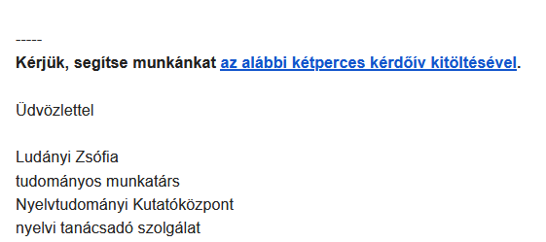
Questionnaire survey about the inquirers and their motivations
Completion of the questionnaire is on a voluntary basis and anonymous
Some basic sociological data (gender, age, highest level of education)
In what situation did the inquirer contact the LCS
Has the inquirer tried other ways to find a solution to the problem
’Please help us by filling in the 2 minute questionnaire below.’
The reason why the inquirer finally contact LCS

Slide 16
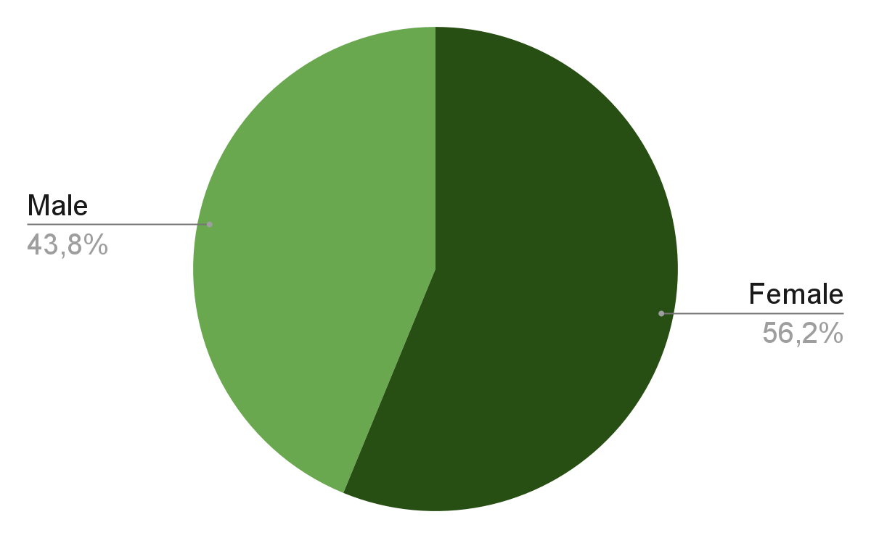
Distribution by gender

Slide 17
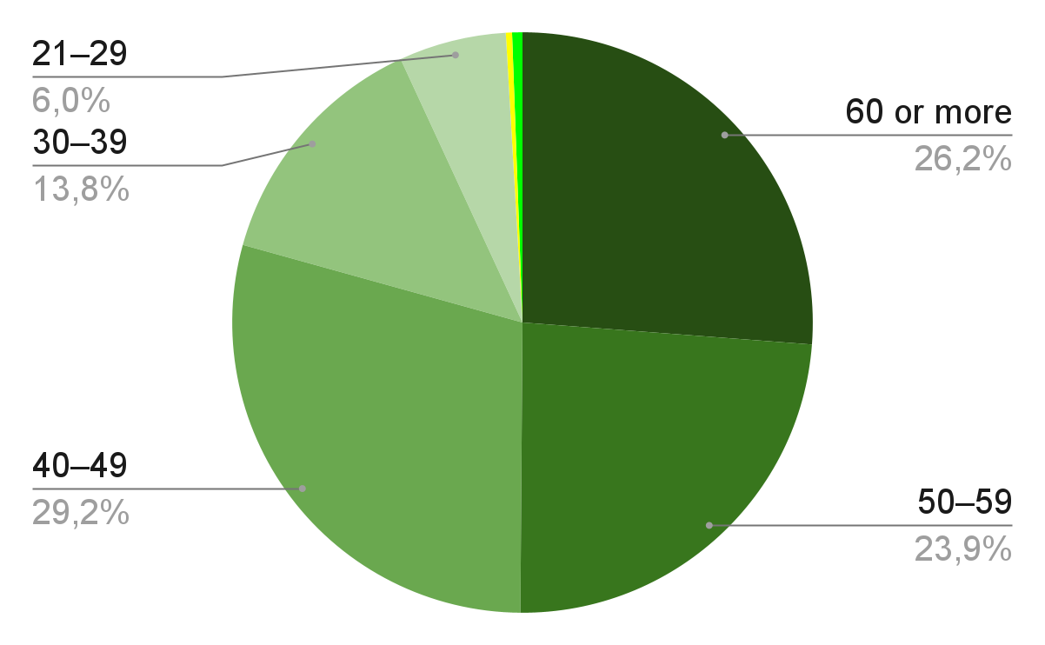
Distribution by age

Slide 18
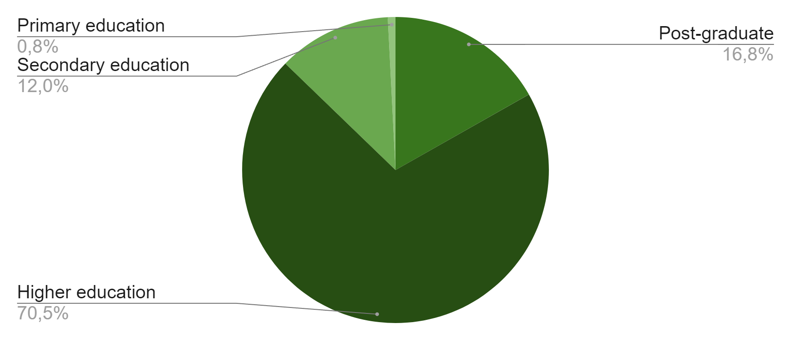
Distribution by education

Slide 19
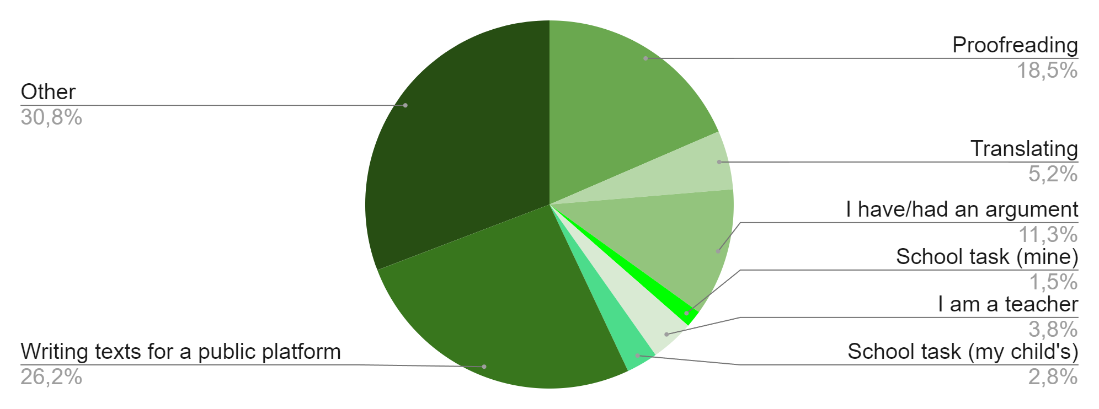
The context of the respondents’ language problems

Slide 20
Some answers to the open-ended question about the context
Correct grammatical expressions and spelling of the text of a PhD thesis.
Thank you for your fast, correct help
I write and publish articles
I am a researcher, and I have some questions for you about writing a study
I'm a graphic designer, I design confectionery packaging, and I occasionally come across text with questionable spelling on the packaging.

Slide 21
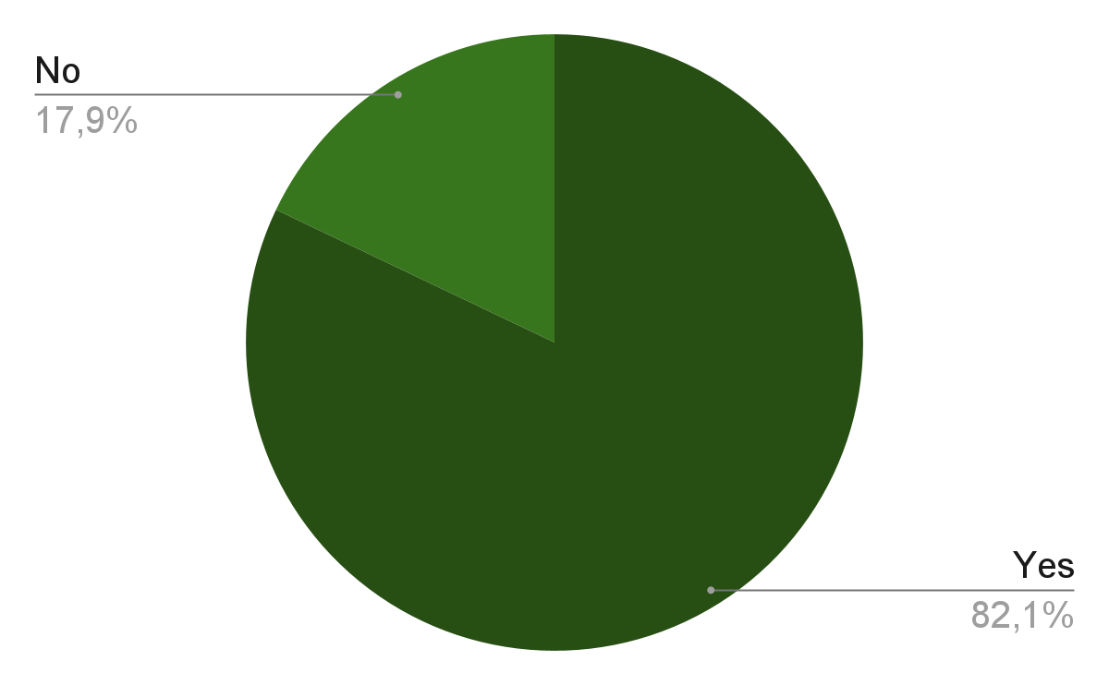
Previously adjustment designs before contacting LCS

Slide 22
Previously adjustment designs before contacting LCS
Searching on the internet
327 responses
Consulting the Hungarian spelling rulebook
248 responses
Consulting dictionaries and/or handbooks
104 responses
Asking friends and family
100 responses
Contacting another language consulting service
32 responses

Slide 23
Some reason why they finally contacted LCS
Recommended by a dear editor friend.
If there is a competent institution for answering questions about grammar, it is the [Hungarian] Research Centre for Linguistics!
I have confidence in their expertise.
I found this alternative on the helyesiras.hu (= Hungarian Spelling Advisory Portal) website.
I came to you because I have received help from you in the past.

Slide 24
The main strategies of language consulting

Slide 25
Language consulting strategies
Answering the questions – development of adjustment design, possible solutions
Language consulting strategies depend on:
the type of problem
the context in which the language problem occurs
the role played by the problem
the motivations and intentions of the inquirer
the inquirer’s adjustment design, preconceptions,
the type of background knowledge to be applied
the availability of resources, databases, dictionaries, corpora, and relevant research
LCS answers:
trying to describe the language problem in question as carefully as possible
taking into account the socio-cultural situation of the inquirer
the criteria of asking and the inquirer’s interpretative framework

Slide 26
An important difference in perspective when answering different questions
Spelling questions
The basic aim is to communicate the spelling norm
The examination of usage is only necessary when spelling codification is absent or inconsistent
Non-spelling questions
The aim is to present the use value of the linguistic phenomenon in question based on linguistic data, research and corpora
Consultants' linguistic ideologies – consciousness
The majority of questions received by the LCS (approximately 81% of emails) are related to normative spelling

Slide 27
Spelling problems in the practice of the LCS

Slide 28
The authority and role of orthographic codification
Hungarian orthography – academic status since 1832 → first normative spelling rule book
Academic spelling is socially accepted, non-mandatory but highly prestigious
Considering academic spelling to be a regulation of essentially unquestionable authority (cf. Beneš et al. 2018: 136–137)

Slide 29
Types of spelling questions
Writing words as one word or as separate words
Spelling of foreign words
Punctuation
Transcribing from foreign languages
Spelling of new proper nouns

Slide 30
Specialised language questions
Specific spelling dictionaries
economy
medicine
technology
chemistry
military affairs
zoology
botany
Answering spelling questions about technical terms is often highly challenging
general spelling rules: lapos tető ‘flat roof’ ↔ architects: *lapostető ‘flat roof’ – a specific type of roof, usually with a pitch of no more than 4–7° → change of meaning
Inquirers’ intention: confirm their professional writing practice confirmed by an institutional authority

Slide 31
Specialised language questions
Applying the spelling rules of certain specialised languages requires a thorough knowledge of the subject matter
E.g. spelling issues of chemistry cannot be settled within the LCS
Drawing the inquirer’s attention to the specific spelling rules and glossaries
Referring them to the relevant committee → Hungarian Academy of Sciences’ Interdepartmental Permanent Committee on the Hungarian Language
Adding a step to the inquirer’s adjustment design

Slide 32
Computer aided spelling advice

Slide 33
Computer aided spelling advice
”Helyesiras.mta.hu” online advisory portal was created in 2013
Motivation: questions received by the LCS
a significant proportion of which are related to the normative spelling
Supporting the work of the LCS
Traditional and newer methods and tools of language consulting co-exist and complement each other

Slide 34
„Is it correct?” spell checker
Spelling of proper names
Hyphenation of words
Should it be written in one word or two (three, etc.)? With or without space or with a hyphen?
Spelling of numbers
Spelling of dates
Sorting in alphabetical order

Slide 35
’Please enter the words separated by spaces’
‘a train that travels fast’
explanation
‘a type of train that stops at only a few stations on the railway line’
Reference to the relevant point of the Rules of Hungarian Orthography

Slide 36
Experience of the Hungarian Spelling Advisory Portal
2013–2024
Satisfied users
An effective solution only for simple questions!
Why?
only subset of the Hungarian spelling rules can be formally described
the lack of spelling codification
The website often redirects the enquirer to "human" language consulting

Slide 37
Language usage problems in the practice of the LCS

Slide 38
Types of non-spelling questions
Request for language advice on language use
the naming of new phenomena
Request for language information
meaning of words
new terms
finding the Hungarian equivalent of foreign words, loanwords
linguistic variants
questions on pronunciation
questions related to linguistic politeness
etymological issues

Slide 39
The basic strategies for answering language use questions
One of common type of inquiries asks for guidance on the correctness or incorrectness of a variant, indicating the strong influence of the standard ideology
Case study: the verb tervez ’plan’ in the auxiliary verb structure
Inquirer: a middle-aged male teacher
[Keresztnév] bácsi el tervez jönni? ’Uncle [first name], are you going to come?’
The verb tervez ‘plan’ in what can be called the Hungarian auxiliary construction – an auxiliary(-like) verb inserted between a so-called preverb (el) and the infinitive (jönni ‘come’)
Strategy:
1. Overview of descriptive grammars
2. Searching for corpus data similar to the structure én el tervezek jönni ‘I am going to come’
3. Drawing conclusions

Slide 40
Hungarian Gigaword Corpus (HGC)
The Hungarian Gigaword Corpus is a representative corpus of present-day Hungarian
1.5 billion word tokens
Mostly comprises texts produced in Hungary
It also contains a significant amount of Hungarian language data from beyond the border (Slovakia, Transcarpathia, Transylvania and Vojvodina).
Annotated corpus:
lemmatisation
part of speech (POS) tagging
morphological analysis for each word

Slide 41
Hungarian Historical Corpus (HHC)
A collection of texts written between 1772 and 2010
In different genres
Around 30 million word tokens

Slide 42
Using HGC in language consulting

Slide 43
Using HHC in language consulting
The verb tervez ‘plan’ is not found in the auxiliary verb structure in texts from 1772–2010
Indeed a recent linguistic phenomenon

Slide 44
Conclusions
Refining the search, manually filtering out false matches
Searching by sub-corpora
The verb tervez ‘plan’ in the auxiliary construction is most common in:
press language (23 matches out of 43 in total)
scientific language use, although in smaller numbers (6 matches)
personal posts on social networking sites (5 matches)
other registers: rare/absent
The teacher inquirer was actually right
The use of tervez as an auxiliary verb is not part of the more formal, more polished registers
Rather casual style of press language
But it is possible that it will also become more common in scientific style

Slide 45
Summary
Historical changes in attitudes to language have created different social systems of language management
A demand for organised language management, including scientifically based language consulting
Bottom-up approach based on the needs of language users, drawing on research and language data
LCS inquiries: typical language problems encountered when producing written, more public, professional or official texts – the highest acceptance of normativity in these registers
LCS practice: relying on linguistic data, research findings, corpora, language technology tools, to help develop adjustment designs

Slide 46
Examined topics in the Research Group
Problems of teaching Hungarian as L1, education-related emails in the LCS database
The role of corpora in language consulting
Language ideologies in the inquiries and in the consultants’ answers
Types of questions about proper names in LCS emails
Spelling issues in the LCS database where spelling codification is absent
Hungarian spelling codification is inconsistent, problematic, contradictory – based on inquiries to the LCS
Pragmatics of language consulting

Slide 47
Thank you for your attention!
Zsófia Ludányi ludanyi.zsofia@nytud.hun-ren.hu | Dorottya Jakab jakab.dorottya@nytud.hun-ren.hu

Slide 48
References
Beneš, Martin – Prošek, Martin – Smejkalová, Kamila – Štěpanová, Veronika 2018. Interaction between language users and a language consulting center: Challenges for language management theory research. In: Fairbrother, Lisa – Nekvapil, Jiří – Sloboda, Marián (eds): The Language Management Approach: A Focus on Research Methodology. Peter Lang. Berlin. 119–140.
Kimura, Goro C. – Fairbrother, Lisa 2020. Reconsidering the language management approach in light of the micro-macro continuum. In: Kimura, Goro C. – Fairbrother, Lisa (eds): Language Management Approach to Language Problems: Integrating Macro and Micro Dimensions. John Benjamins. Amsterdam. 255–267.
Nekvapil, Jiří 2009. The integrative potential of Language Management Theory. In: Nekvapil, Jiří – Sherman, Tamah (eds): Language Management in Contact Situations: Perspectives from Three Continents. Peter Lang. Frankfurt am Main. 1–11.
Rudwick, Stephanie 2022. Language politics at Stellenbosch University, South Africa. In: Marek Nekula – Tamah Sherman – Halina Zawiszová (eds.): Interests and Power in Language Management. Peter Lang. Berlin–Bern–Bruxelles–New York–Oxford–Warszaw –Wien. 101–122.

